Slide 1
Capacity forecast on DALI data.
Spa
rk
Bram Vonk, JADS-Enexis
July 20 2021

Slide 2
Inhoud komend half uur
Recap vorige sprint review (5 min)
Resultaten sprint
Data (5 min)
Model (10 min)
Werk komende sprint (2 min)
Discussie (8 min)

Slide 3
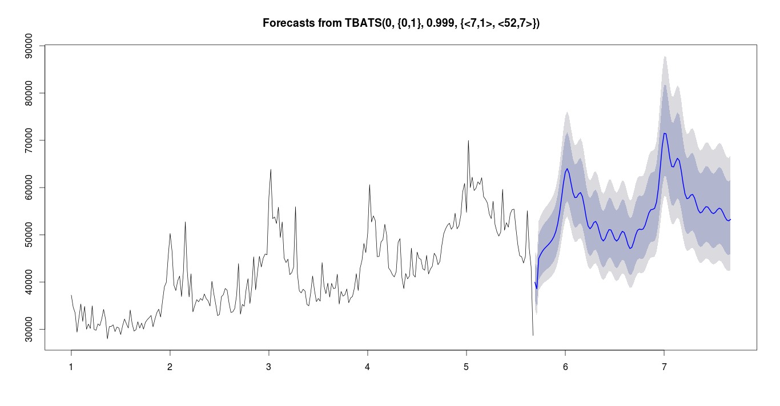
Recap vorige sprint
Project doel
Forecast 6-12 maanden vooruit de capaciteitsvraag op basis van DALI data.
Voorbeeld:
In de herfst kunnen bepalen met bepaalde zekerheid of er in de lente issues komen.
transformer limit
transformer
loading
autumn
spring
historic data
forecast

Slide 4
Feedback vorige keer
Plot lijntje met max capacity
Niet interessant voor forecast
Wel voor visualisatie (metadata is er)
→ Later bij visualisatie doen
Verslaglegging
Sprint 1 → i.v.m. tijd *.ppt i.p.v. verslag
Sprint 2 → maak beiden …
→ Nu vastleggen keuze
Trend (→drift) als taylor reeks
Exponentieel geimplementeerd
Issues met trainen model
Discussie
Model minder aandacht geven
Leerpunten liggen elders → productie

Slide 5
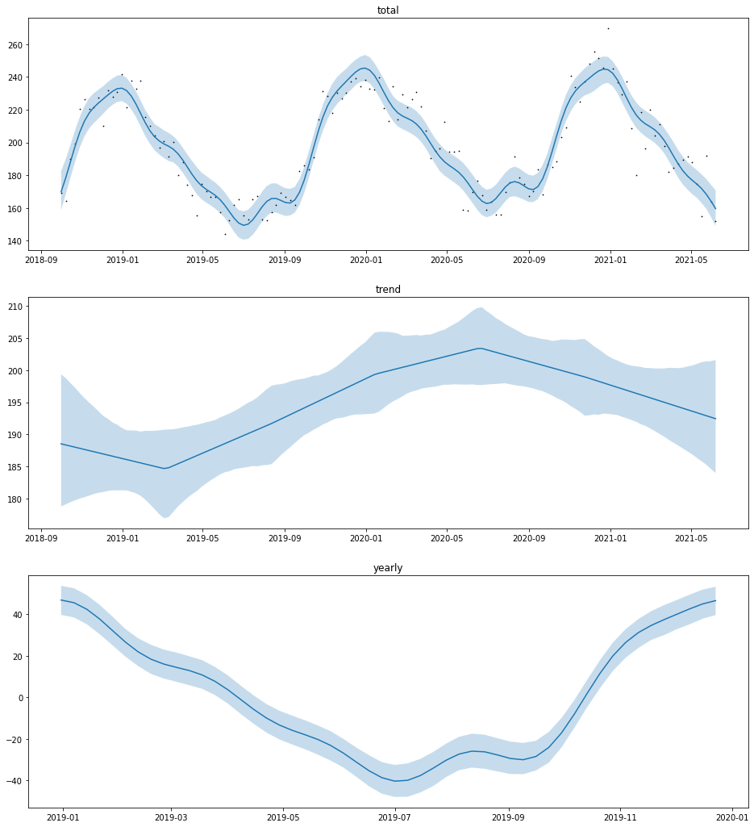



monthly / weekly
monthly
always
model
weekly extremes
dashboard

Slide 6
backlog
Business Understanding
Data Understanding
Data Preparation
Modeling
Evaluation
Deployment
Transfer code to functions
Write forecast quantiles in DB
Backcast function for evaluation
Scheduled train + forecast
Reusable plot function
order / priority
Setup task for every month
Determine GUI with business
Deal with switch action in model
24/7 accessible tool
Dashboard results online
Model trend exponential function
Documentation online
Assess results with business
Scheduled data preprocessing
Detect max date specific week
Sorting algorithm for priority
Setup task for every week
Delete data from specific week
Export data for grid planning
Overload signaling
Shortcut to meetdata dashboard

Slide 7
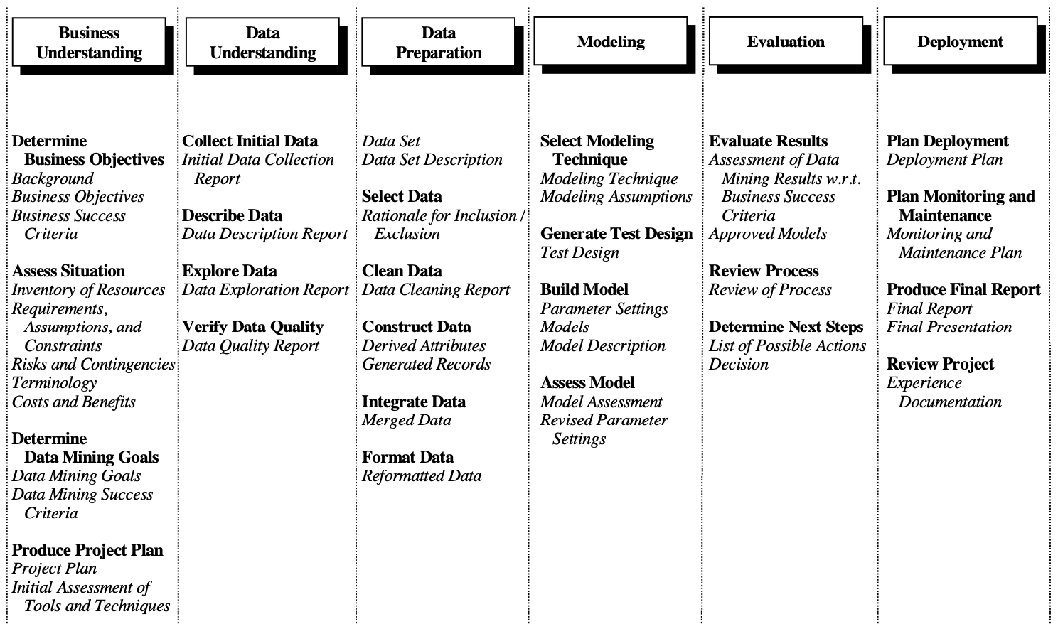
Way of Working vanuit Data Science/JADS: CRISP-DM
Business Understanding
Data Understanding
Data Preparation
Modeling
Evaluation
Deployment

Slide 8
Focus of this sprint
Business Understanding
Data Understanding
Actions Bram
Explore possibility max/min values
Look at data quality
Solution on missing data
Use data in experimental model
Actions Grid Planners
5-10 DALI boxed transformers (with overloading history)

Slide 9
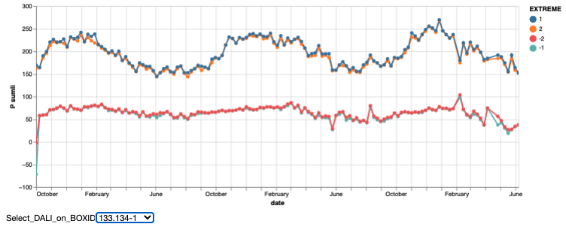
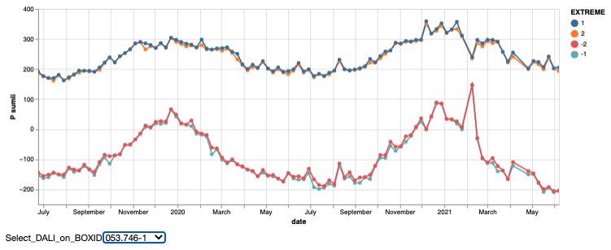
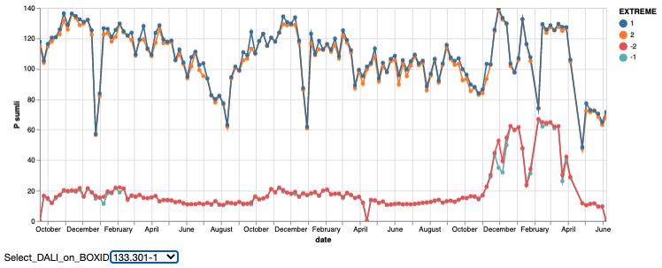
Data
10 random Dali trafo’s from metadata
7/10 existed in measurement table
4/10 had enough data (>2 year history)
General observations
Missing data draws extremes to mean
Completely missing weeks are interpolated
Weekly min and max are sufficient
No added value 2nd extreme (same as 1st)
Simplifies query
Sometimes weird situations (switching?)

Slide 10
Flow Down Business value
Business Value
Safety
Reliability
Affordability
Sustainability
Company KPI
Overloading
Outage
Claims
Ad hoc resources
Planned resources
Project KPI
Do nothing
Ad hoc replacement
Stop growth
Planned replacement
Possible actions
Optimal planning transformer replacement
Model Usage
Forecast Model
Transformer overloaded soon
Model result
Future timeseries P / S DALI
Y variables
Nominal power of transformer
Historic timeseries P / S DALI
X Variables

Slide 11
Requirements for achieving value
Model
Explainable
Forecast has prediction intervals
Forecast horizon 6-12 months
Uses prior information of population (if data is limited)
Usage tool
No separate log in/install
Quick visualisation of results (no waiting)
Scalable up to 35k transformers
Sorting on urgency
Reliable (tool + forecast)
Export results possible for other tools (e.g. Vision, Power BI dashboards)

Slide 12
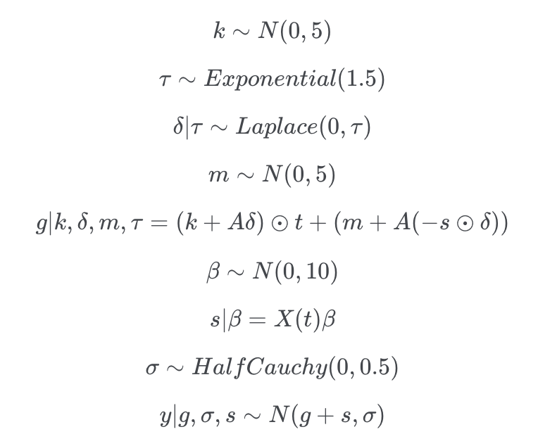
Model structure
Generalized Additive Model
Picked DALI box 133.134-1
Total = trend + year component

Slide 13
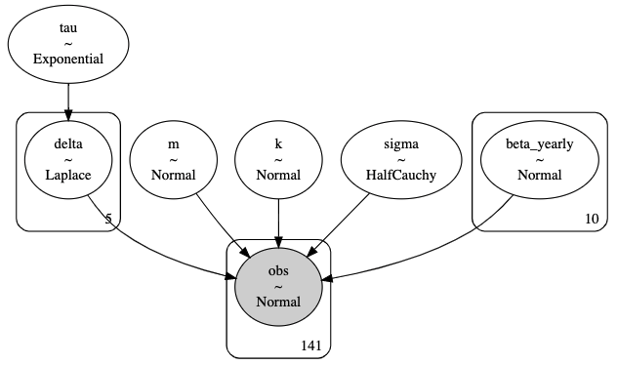
Model structure
Generalized Additive Model
Picked DALI box 133.134-1
Total = trend + year component

Slide 14
Model parameter estimation
On historic / observed data
95% quantile band (needs attention)
Issues with scaling of data for estimation

Slide 15
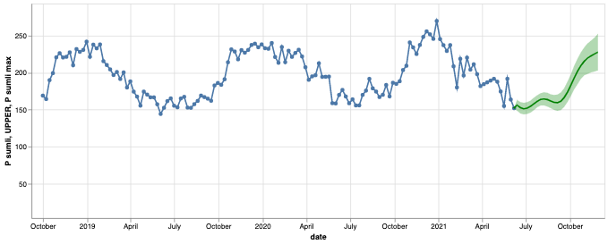
Forecasting with model
First impression → not too bad
Next step → validation with data
Request → overloading use cases

Slide 16
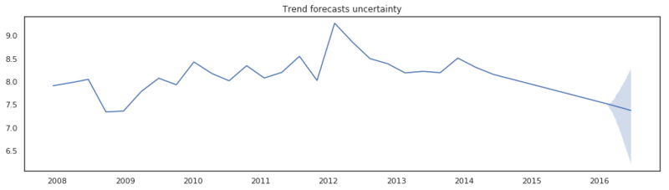
Issue with trend changepoints
Proposal:
Only changepoints on observations, not on expectations.

Slide 17
Focus komende sprint (in september, na verlof)
Data Preparation
Verder met
Data Preparation → set op S3
Model → opzetten testcases

Slide 18
Discussion

